Slide 1
Welcome to Our New Grade One Parents 2021 Edenglen Primary School

Slide 2
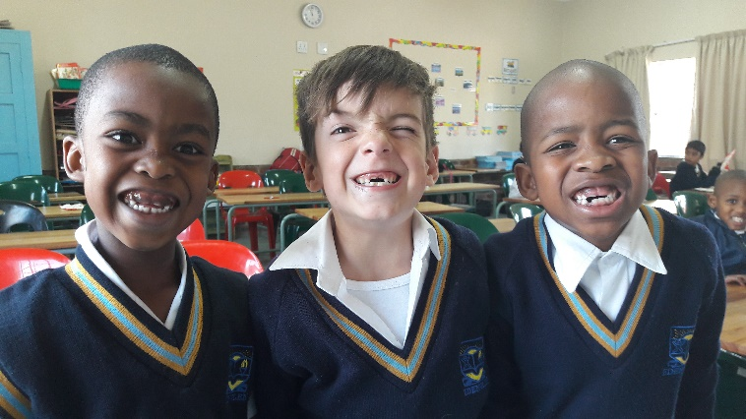
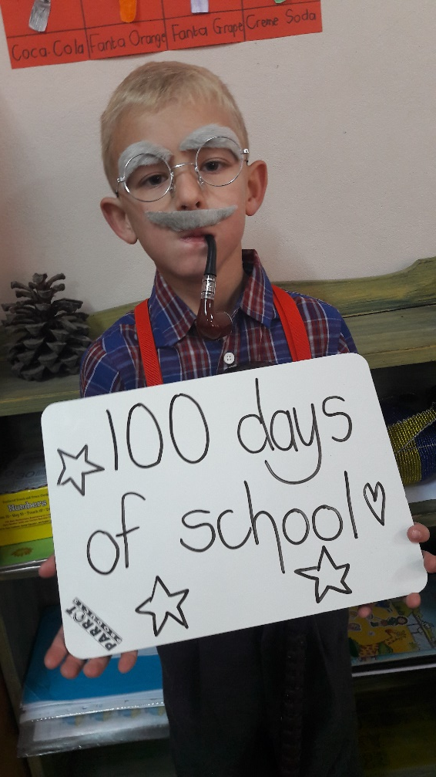
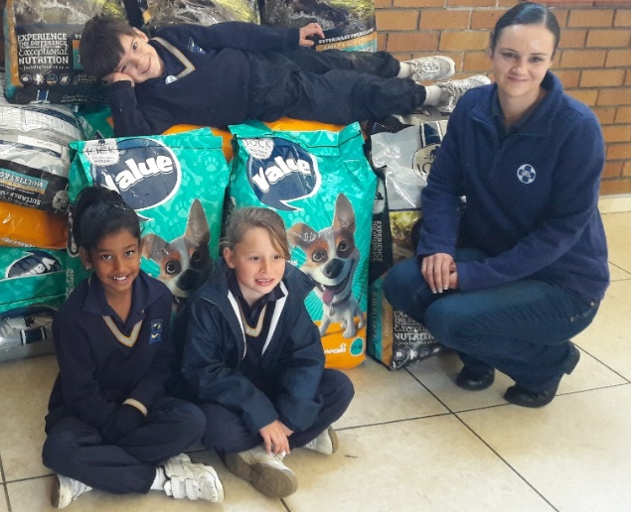
You have a great deal to look forward to...

Slide 3
Learner

Slide 4
WELCOME PACK
Plastic envelope
Library bag
Information brochure
Homework diary
Labels
PPE
Welcome Packs will be handed out on Saturday, 12 December 2020.

Slide 5
INFORMATION
You will also receive the following in the Welcome Packs:
Stationery list
Information leaflet
Karri App brochure
Stationery Brochure
Makro Card forms

Slide 6
SCHOOL TIMES
School starts at 07:45 – please ensure your child is on time.
Please do not walk your child into school.
“Feeding Time” at 10:00
One half hour break.
School closes at 14:00 on Mondays to Thursdays and at 13:30 on Fridays – please ensure your child is fetched on time or supervised in the afternoons.
Aftercare – Teacher Bev

Slide 7
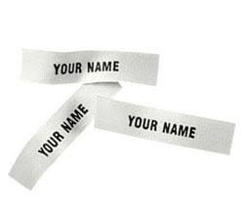
UNIFORM
Please label ALL clothing – labels in Welcome Pack
Caps are compulsory.
The lost property room / second-hand shop is open every afternoon straight after school.
Teachers are not responsible for any missing items.
Children must be neat and tidy at all times (refer to diary for uniform rules and the correct day for P.E. uniform / library bag).
If your child forgets his / her P.E. uniform or library bag please DO NOT drop it off at the front office.

Slide 8
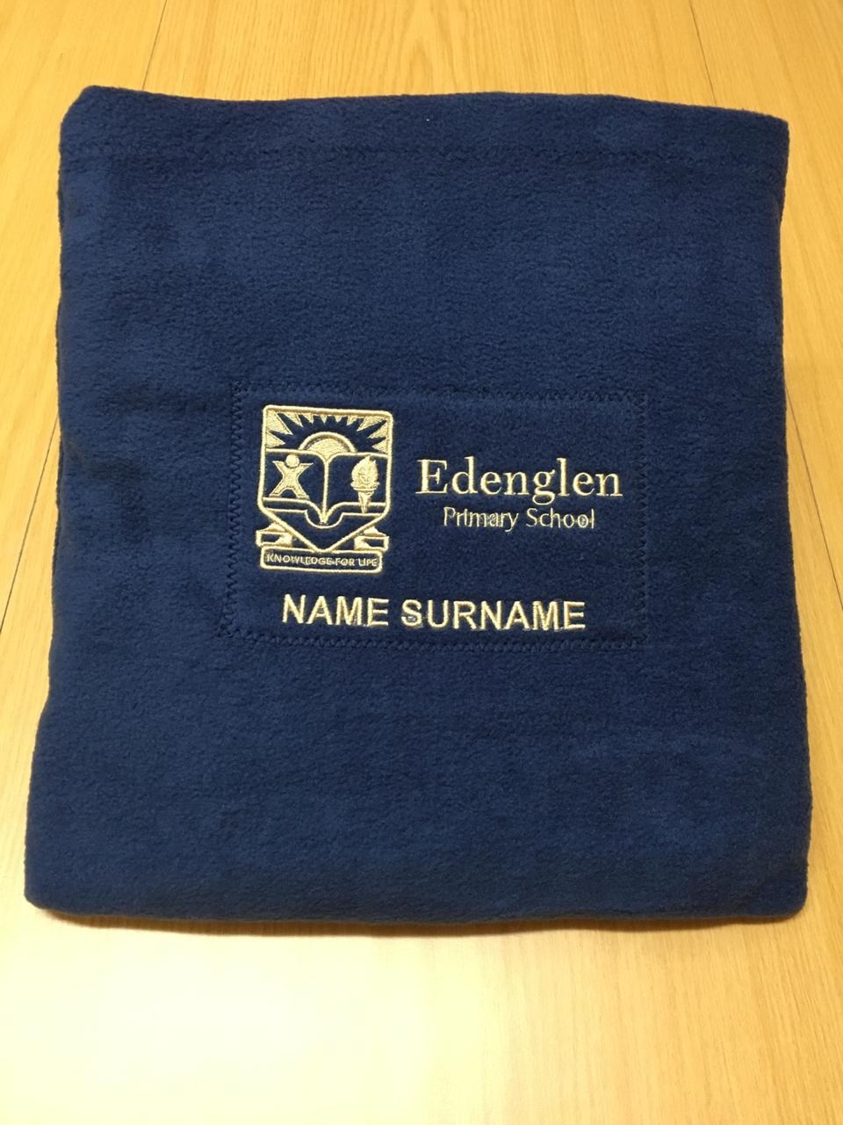
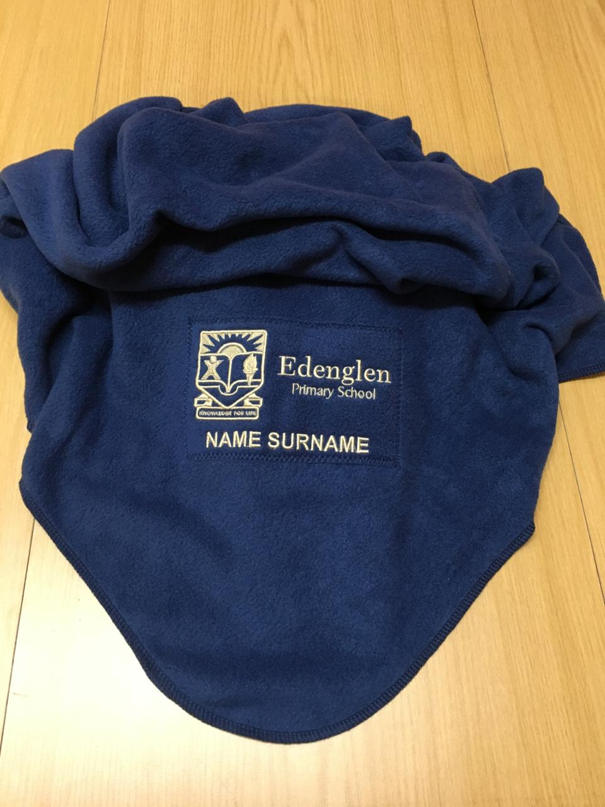
UNIFORM
Blanket for Winter
Order forms will go out in the first term.
Embroidery – name and surname.
Cost depends on embroidery.

Slide 9
STATIONERY
Stationery list.
Stationery must be labelled with your child’s name.
Please keep a portion of stationery at home so your child can complete his / her homework.
Extra stationery is kept in the class storeroom for convenience and prevention of disruptions.
Left over stationery will be returned to you at the end of the school year. Sundries will not be returned.
Lost stationery is not the responsibility of the teachers.

Slide 10
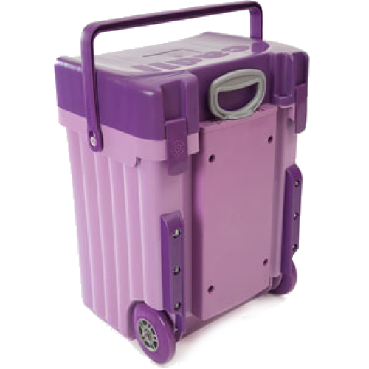
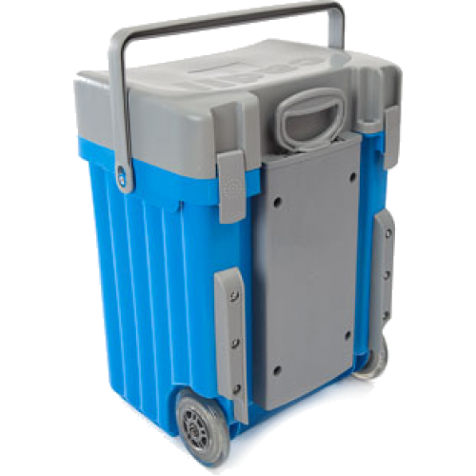

Slide 11
HOMEWORK
There are two homework books: the blue homework diary and the printed workbook.
The blue diary must be signed by PARENTS every day.
No homework on a Friday.
Use your child's diary as a form of communication (no long messages please).
Please make sure your child has stationery at home to complete homework.
Please check the school Communicator often: www.school-communicator.com

Slide 12
READING
Learners will be issued with a reader and reading card.
The reading card MUST be signed every day by a PARENT, not only by the aftercare teacher.
If the reading card is not signed, new reading will not be given.
Please do not change the pages assigned by the teachers (we focus on pronunciation, punctuation, fluency, expression etc).

Slide 13
We welcome comments or requests for the same reading.
Damaged and lost readers cost R250,00 to replace. Lost library books vary in price.
Please decorate your child’s library bag so that it can be easily identified.
No library bag: de-merit. Packing the library bag for school must become your child’s responsibility.
We encourage a love for reading. Take this time to read with and to your child.

Slide 14
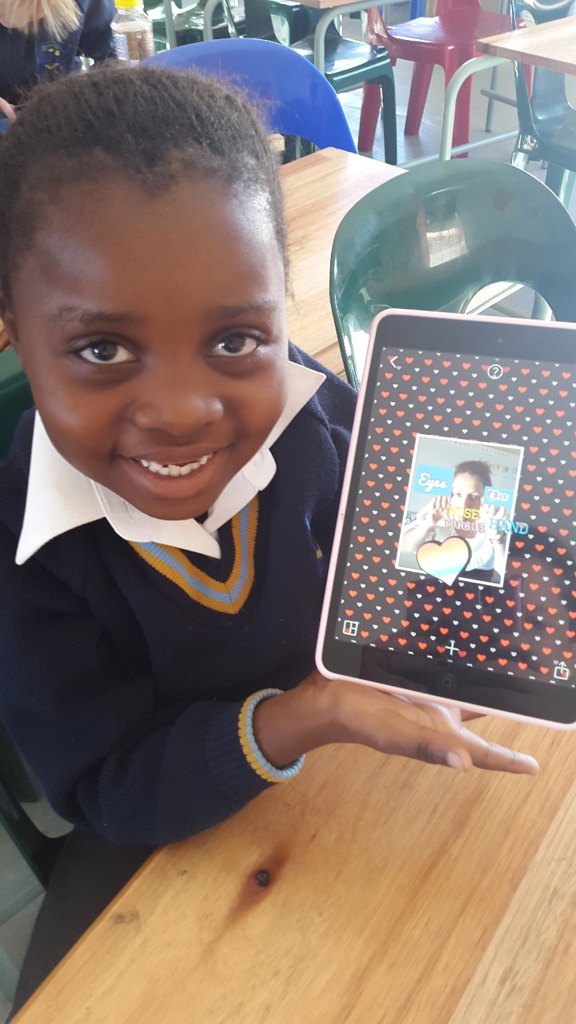
Technology in the Classroom
We strive to prepare your children for the future.
Technology is a valuable learning tool.
iPad Labs used once a week as part of curriculum mediation.
There are many apps that can be used to enhance your child’s education.

Slide 15
DISCIPLINE
Children need structure and rules to feel safe.
Merit system – merits are given for positive behaviour - good work, responsibility, honesty, good reading etc.
Demerit system – consequence of negative behaviour; not punishment.
Teachers give verbal and written warnings before issuing demerits unless exceptional circumstances.
BED TIME! Please ensure your children go to bed at a reasonable hour every night.
Consistency in discipline between home and school is important. Please support a teacher’s decision to discipline your child. A united front is imperative!

Slide 16
LEARNER SUPPORT
Occupational Therapy
Speech Therapy
Remedial Therapy
Smart Brain (English and Afrikaans)
All of the above therapies are
available at the school. Some medical aids cover the cost of some therapies.
Extra lessons are part of our extra-curricular timetable. These lessons are by invitation only.
Teachers will identify which learners are in need of support or therapy. We would appreciate your full support in this regard. We have your child’s best interests at heart.

Slide 17
COMMUNICATION
Please use the homework diary to communicate with your child’s teacher (primary means of communication). Teachers will respond to any communication straight away.
You will be given your child’s class teacher’s email address at the beginning of the year. Teachers will respond to emails within 48 hours.
Should you request a meeting with your child’s class teacher, please do so via email or in the homework diary. Teachers cannot respond to phone calls during contact time.
Should your child’s teacher request a meeting with you, please make every effort to attend the meeting. Please confirm attendance. Appointments need to be confirmed. Please do not arrive in the morning or afternoon without an appointment, expecting to talk to a teacher.

Slide 18
COMMUNICATION
Any issues that you feel may not have been resolved by your child’s class teacher may be referred to the Grade Leader. From there, the matter can be referred to the Foundation Phase HODs, Deputy Principals and if necessary, the Principal.
Please ensure that we have the correct contact information for you. It is important to complete the front page in the homework diary and to keep it updated – “Personal Information Page”.

Slide 19
ABSENTEEISM
PLEASE TRY KEEP ABSENTEEISM TO A MINIMUM. Inform the school if your child is absent. We worry about your children.
A doctor’s note is needed should your child miss an assessment. We assess your children on a continuous basis. School policy states that a learner will receive 0 for an assessment should a doctor’s note not be provided.
Should you provide us with a valid doctor’s note, your child will be given the opportunity to catch up any missed assessments.
Please do not go on holiday during the school term.
If your child is genuinely ill, please keep him / her at home. It becomes very disruptive to have sick learners at school.

Slide 20
TUCK SHOP and LUNCH
Lunch costs between R20 and R30. Menu will be available on the Communicator.
Lunch cards can also be bought – parents load money onto these cards. This is safer option as children may lose money.
Our focus is on healthy eating and we suggest tuck as a “treat day”.
Please do not send large amounts of money to school.
When bringing lunch to school we would like to see a healthy lunch box. Crisps, sweets, chocolates and muffins can be a treat on a Friday.
Please do not pack fizzy cold-drinks. Please ensure juices and water are sealed to avoid accidents.
Please pack the correct eating utensils should you give your child yoghurt / salad etc.

Slide 21
EXTRA MURALS
Change each term (notices will go out with details).
Sports, cultural and extra lessons.
Encourage your child to participate in extra murals.
Learners leave from class and must be collected straight after their activity.
No cost involved.

Slide 22
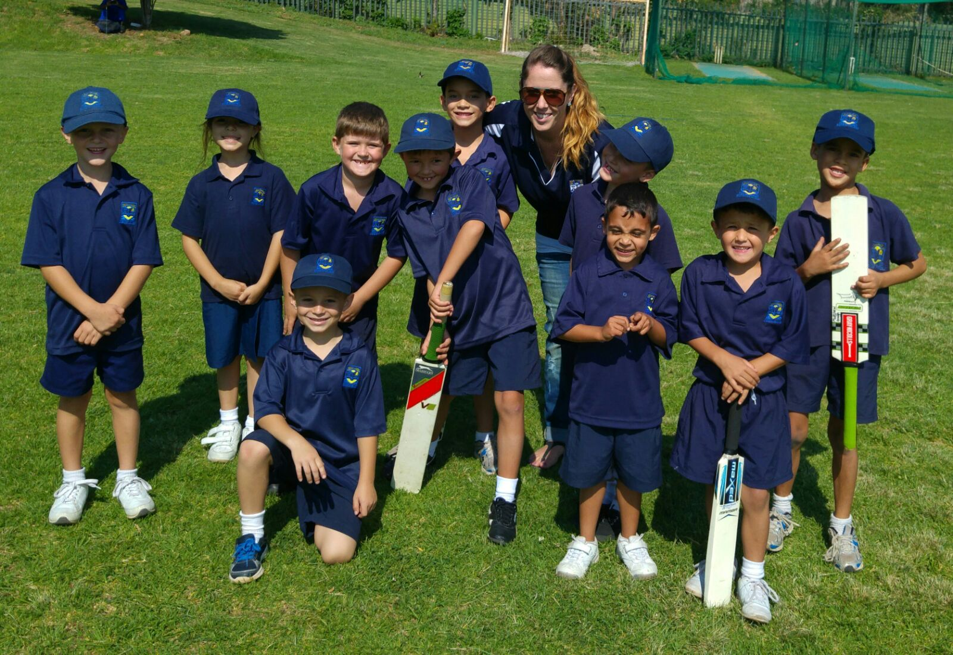
MINI CRICKET
Term One and Term Four
Boys and girls
Team selection is on a rotational basis.
Matches are on a Saturday morning.
Learners need their own cricket bat, PE kit and school cap.

Slide 23
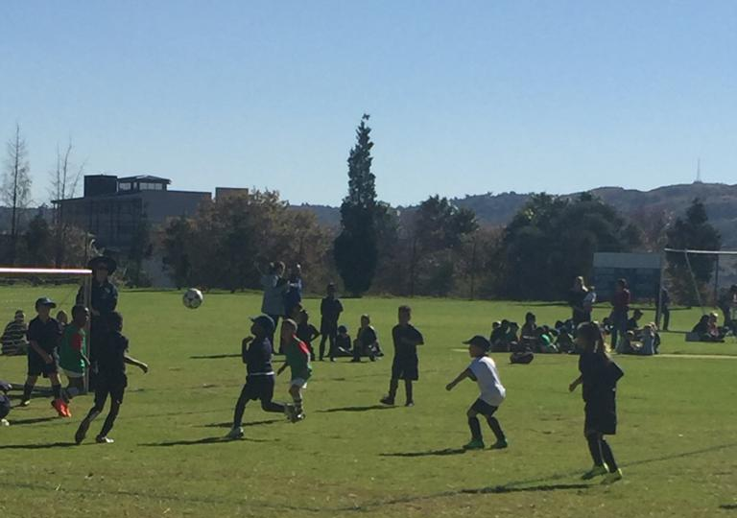
Term Two
Boys and girls
Team selection is on a rotational basis.
Matches are on a Friday afternoon.
Soccer boots / takkies, school cap and shin pads.
MINI SOCCER

Slide 24
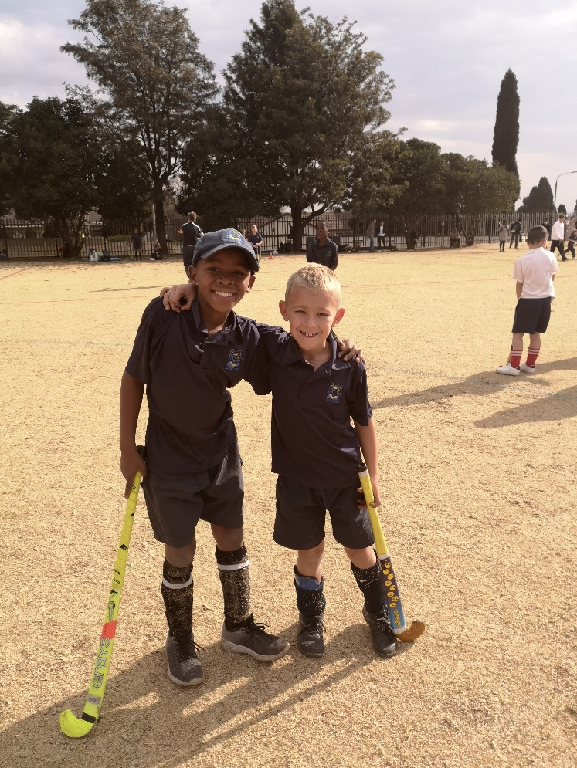
MINI HOCKEY
Term Three
Boys and girls
Team selection is on a rotational basis.
Matches are on a Thursday afternoon.
Learners need to have their own hockey stick.
Shin pads, takkies, school cap and gum guard.

Slide 25
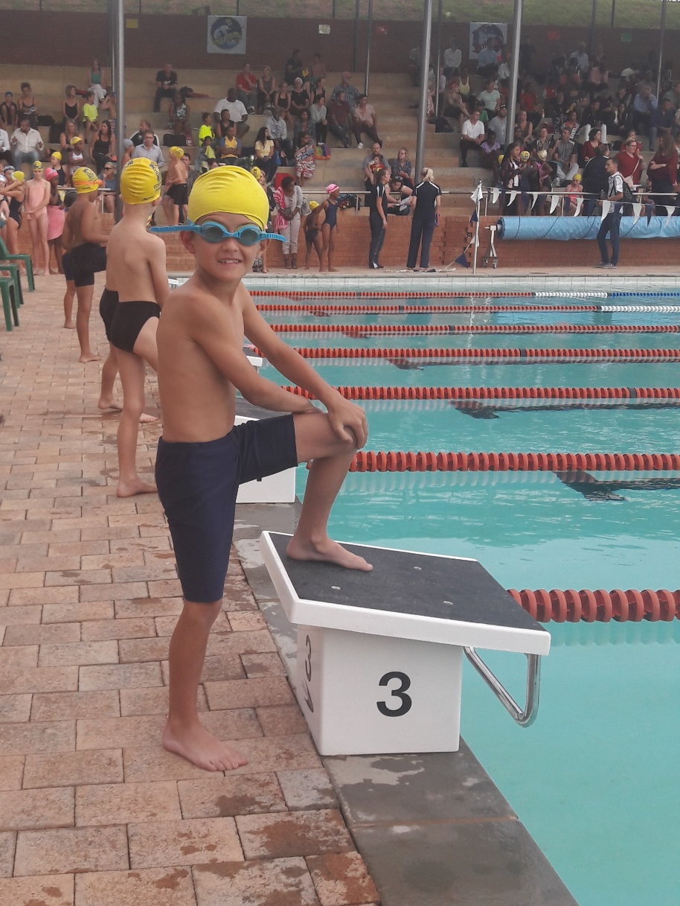
SWIMMING
Term One and Term Four
Boys and girls
Your child needs to be able to swim the full length of a pool (25m) without assistance. Strokes must be developed.
Galas are on a Friday afternoon.
Navy blue swimming costume, yellow Edenglen Primary School swimming cap.

Slide 26
Various cultural activities:
Throughout the year.
Eisteddfod (Poetry – English and Afrikaans)
Art Eisteddfod
Choir
Recorder Ensemble
There is a small cost to participate in these activities.

Slide 27
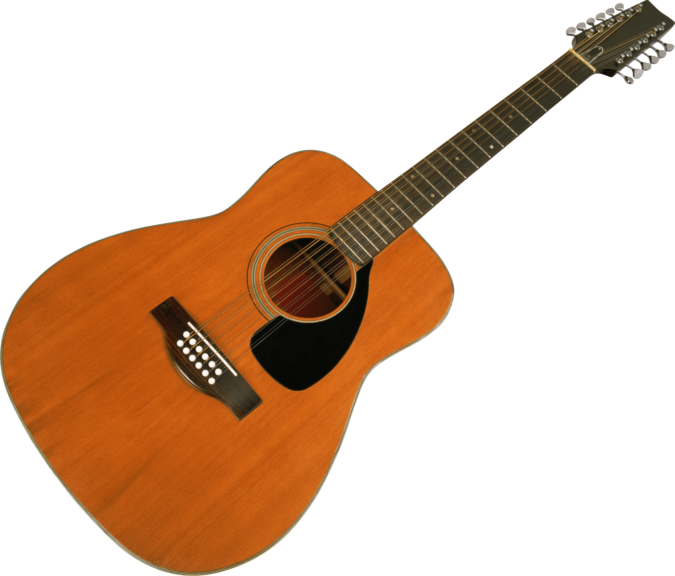
Co-Curricular Activities:
CLEVER CODERS
Clever Coders introduces young children to the exciting world of computer programming in a fun, hands-on and understandable manner, nurturing children’s imaginations and creating a whole new world of play.
Extra cost
Brochure will be handed out today.
GUITAR LESSONS
Music participation provides a unique opportunity for literacy preparation. It directs children to listen and hear in new ways which improves their aural discrimination.
Extra cost
Information will be handed out early next year.

Slide 28
Aftercare
Grade One Aftercare is privately run at Glenvale Nursery School.
Please contact Bev Maggot: 082 734 7976

Slide 29
SCHOOL CAN BE A MAGICAL PLACE…
Form a positive relationship with your child’s teacher.
Have a positive outlook towards school and school events – attend as many functions as possible.
Lead by example – children learn social skills from parents.
Listen to your child – make him/her feel valued.
Tell your child that you are proud of him / her.

Slide 30
Support your child emotionally.
Do not discuss your child’s teacher in front of them.
Talk about what your child is currently learning in class and what happened during the day.
Encourage your child – if your child is afraid of failing and disappointing you!

Slide 31
Growth Mindset
“In a growth mindset, people believe that their most basic abilities can be developed through dedication and hard work—brains and talent are just the starting point. This view creates a love of learning and a resilience that is essential for great accomplishment. Virtually all great people have had these qualities.” Dr Carol Dweck

Slide 32
How You Can Help…
ALLOW YOUR CHILD TO ACCEPT, GROW AND MATURE THROUGH CONSEQUENCES.
Help your child work through possible solutions to problems – ask “What are you going to do about it?”
Develop, invest & engage in your child’s interests.
Develop your child’s identity.

Slide 33
February – Grade One Meet and Greet
February – How to Survive as a Grade One Parent

Slide 35
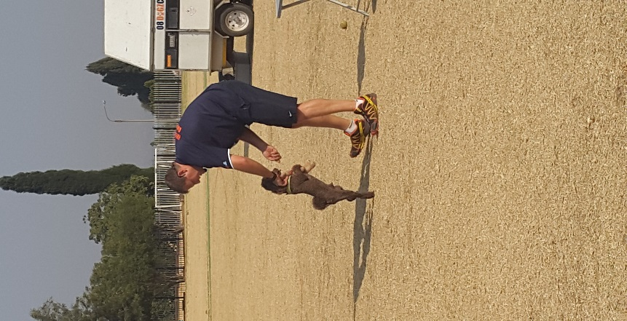
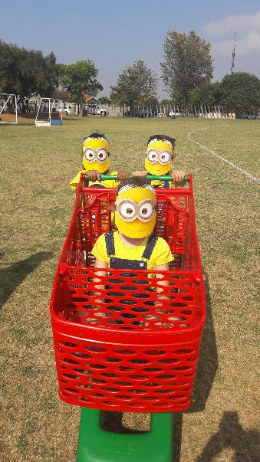
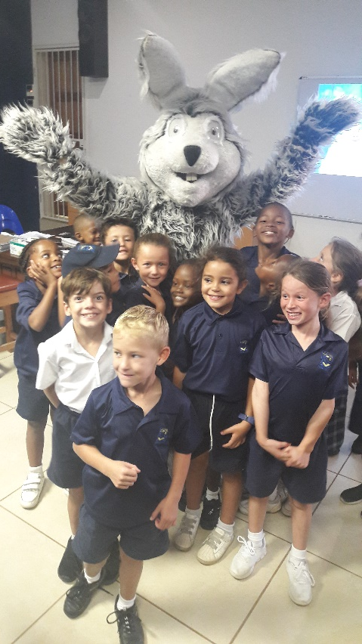
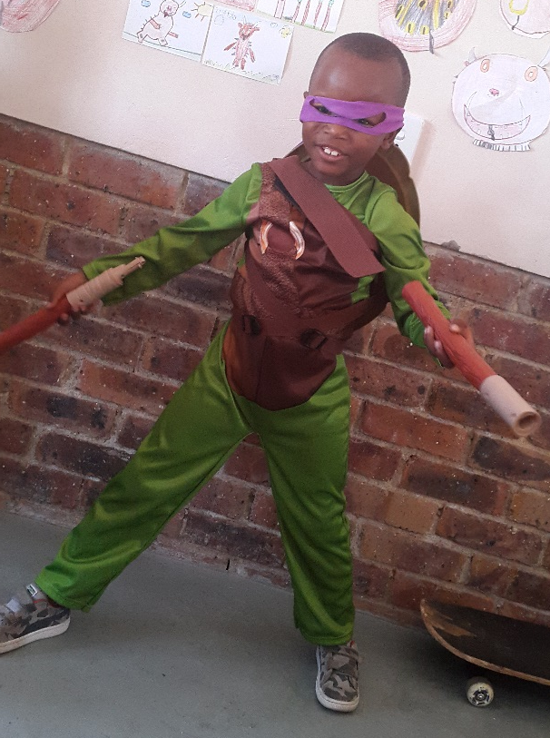
We look forward to a memorable and enjoyable Grade One year!

Slide 36
THANK YOU AND WELCOME TO THE EDENGLEN FAMILY!

Slide 39
